Slide 1
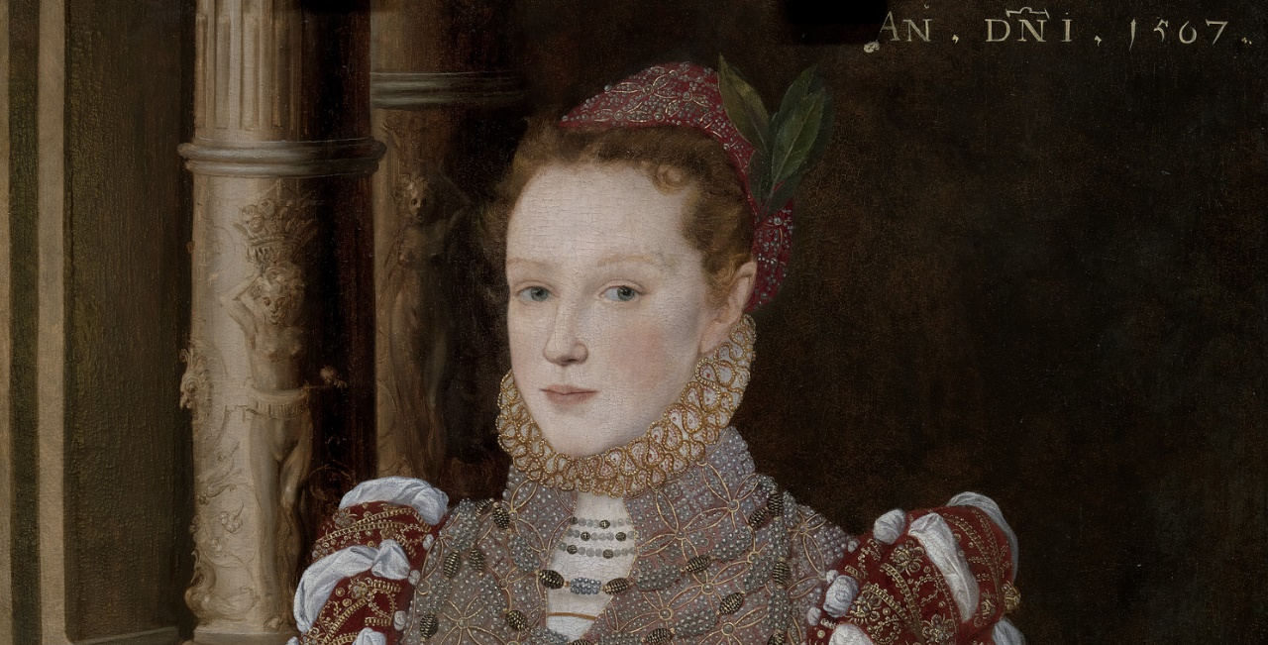
International Image Interoperability Framework in the museum:
image based scholarly collaboration and research
Emmanuelle Delmas-Glass,Collections Data Manager @edgartdata @YaleBritishArt #CIDOC2016

Slide 2

Researchers’ requirements
Interoperability between image silos
Manipulate images
Collaborate with colleagues across the world

Slide 3
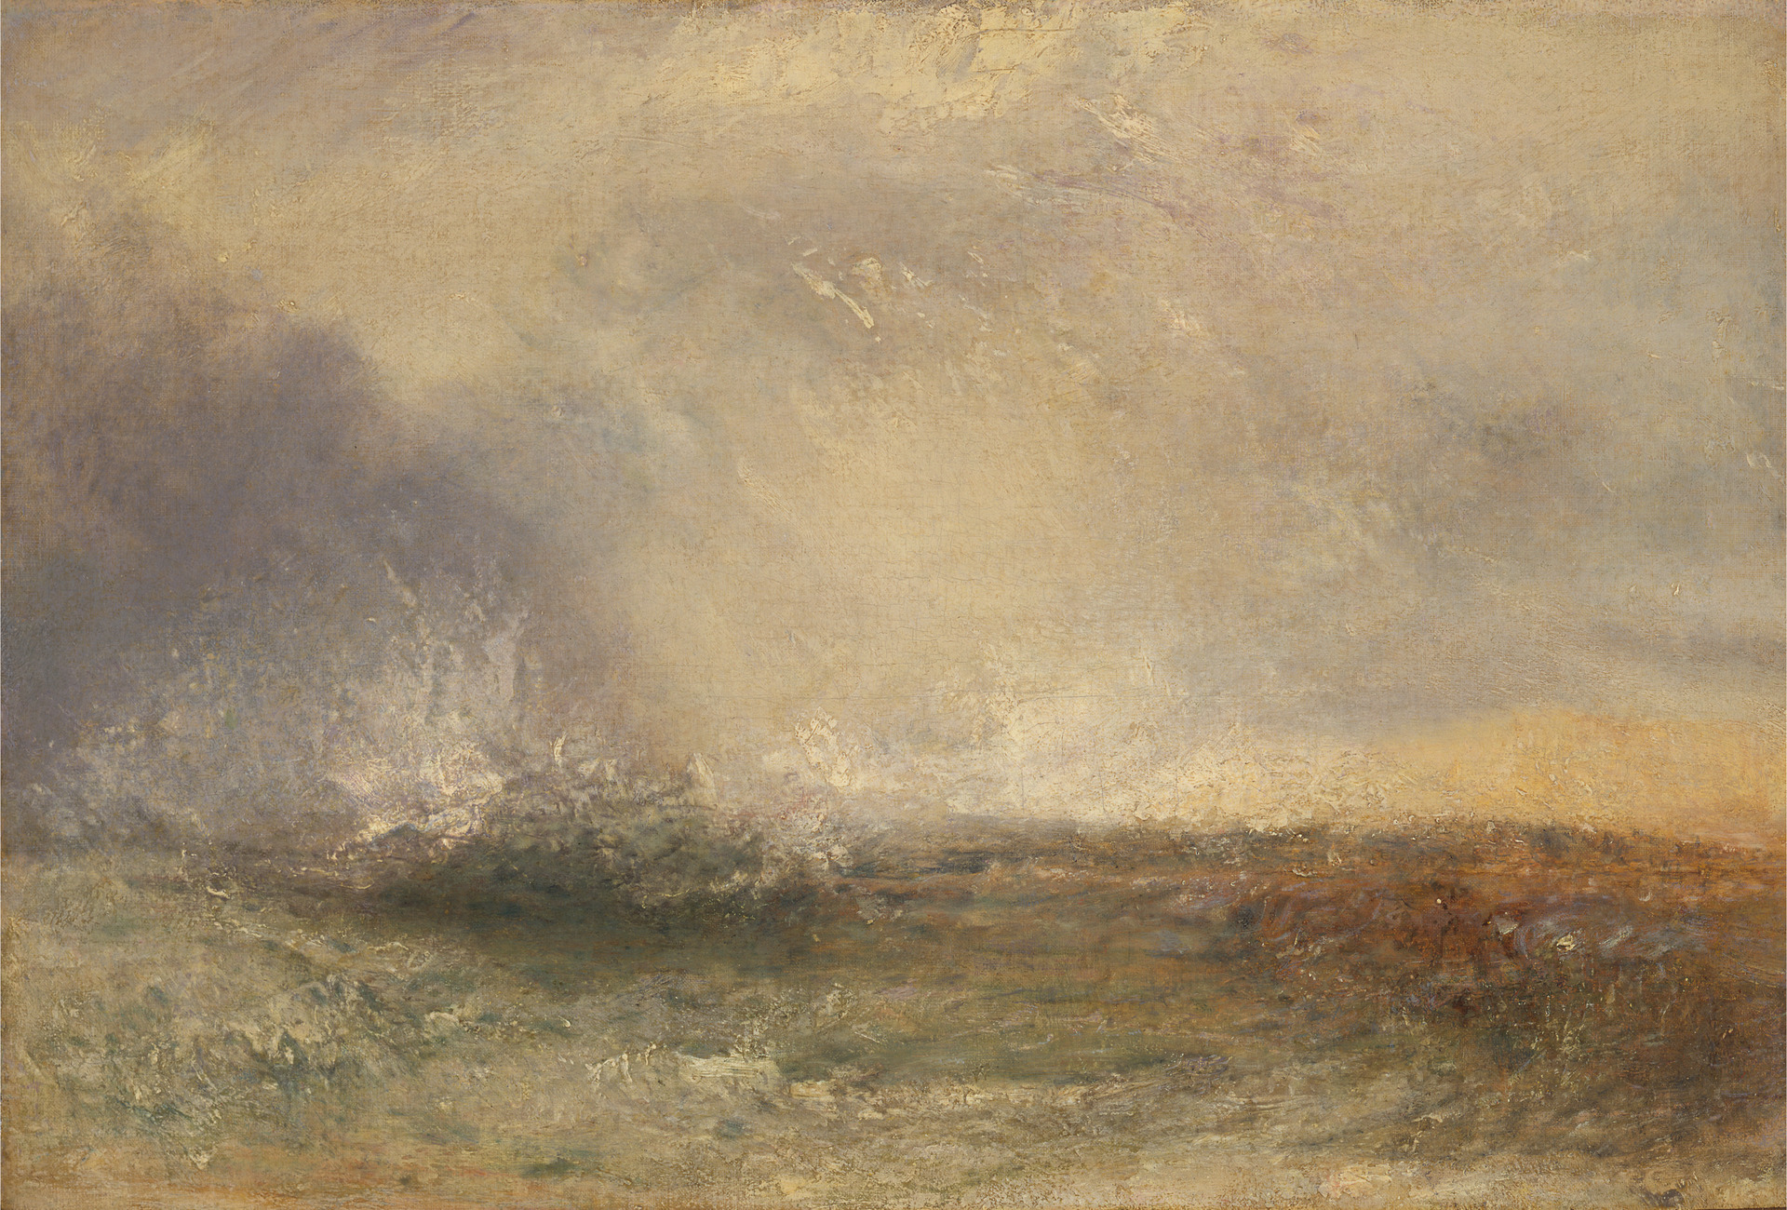
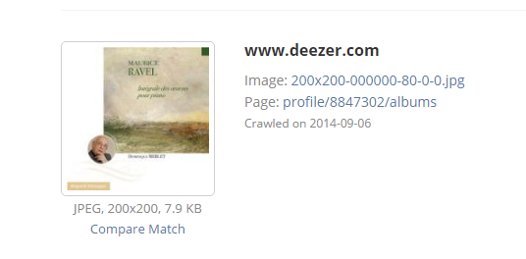
Researchers’ requirements
Tineye.com
Joseph Mallord William Turner, 1775–1851, British, Stormy Sea Breaking on a Shore, between 1840 and 1845,
oil on canvas, Yale Center for British Art, Paul Mellon Collection, B1981.25.632
http://collections.britishart.yale.edu/vufind/Record/1665464

Slide 4
Museums and funding institutions’ requirements
Stop funding/developing technological solutions for short lived projects/proprietary silos
Invest in community developed standards and technology that leverage museums’ digital assets and data (LIDO, CRM, IIIF)
Develop long term technological solutions that support the whole institution, not just projects
Develop long term technological solutions that make the museum relevant in the network environment

Slide 5
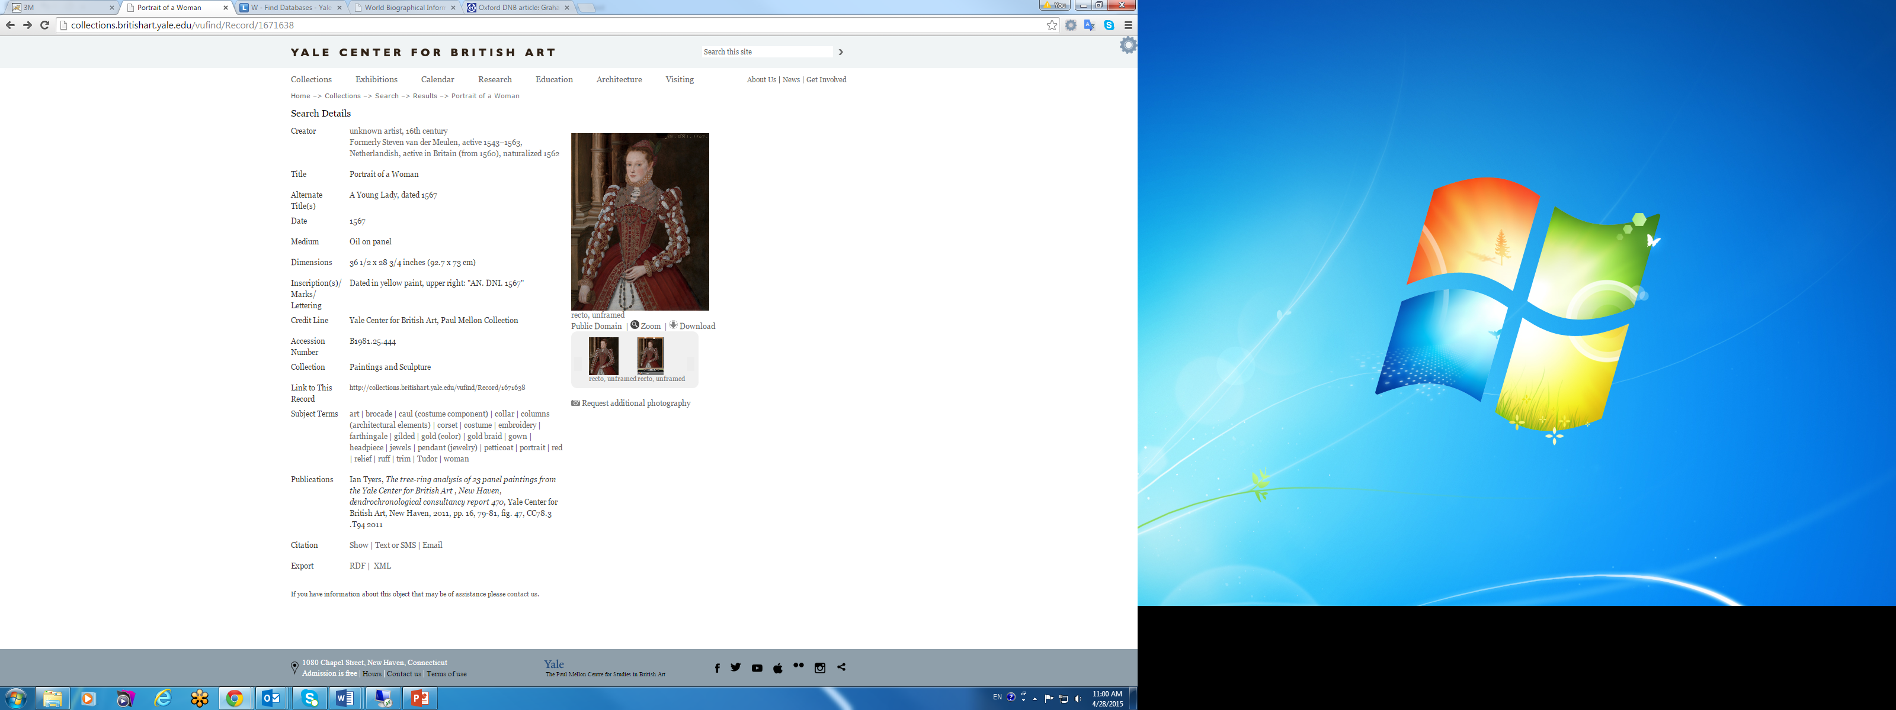
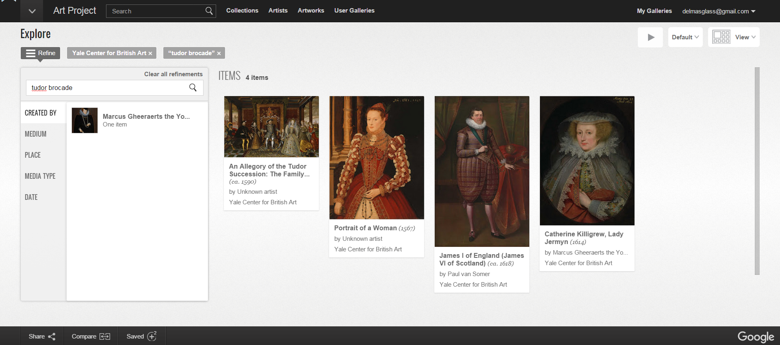
Access through machine readable format
OAI-PMH (Open Archives Initiative Protocol for Metadata Harvesting)
LIDO XML (Lightweight Information Describing Works of Art)
OCLC’s open source COBOAT & OAICatMuseum
http://britishart.yale.edu/collections/using-collections/technology/linked-open-data
Notes:
But the website is the tip of the iceberg for us. We also disseminate our digital resources in a programmatic fashion, which is more efficient when dealing with large data aggregators, such as Google and Artstor or even Yale’s own Cross-Collections Discovery service. How did we do that? We contributed our dataset via the OAI-PMH (Open Archives Initiative Protocol for Metadata Harvesting) data exchange protocol called following an international XML metadata harvesting schema called LIDO.
Both LIDO and OAI-PMH are community developed standards and work with the open source software that were designed by CoggApp for OCLC Online Computer Library Center. It is worth mentioning that YCBA’s David Parsell reconfigured COBOAT to work for LIDO since COBOAT was originally configured to work with CDWA Lite.

Slide 6
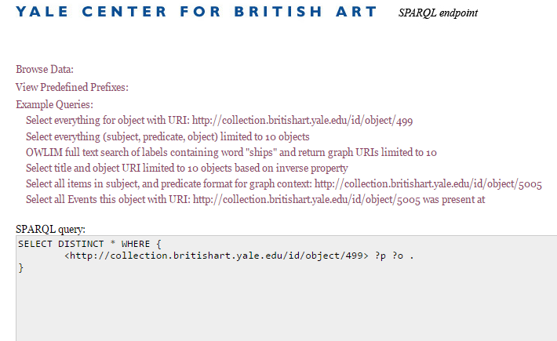
Access through machine readable format
Linked Open Data semantic endpoint
CIDOC-CRM (Conceptual Reference Model)
Notes:
Machine readable data can also be accessed querying our Linked Open Data semantic endpoint. As many other cultural heritage institutions, the Center has been digitizing its collections for quite some time (cataloguing and imaging) but unlike many others, at least in the United States, it has taken the additional step to organize its data with an ontology called the CIDOC-Conceptual Reference Model. The CRM has been developed over many years, and is still developed by a community of active cultural heritage institutions practitioners, and is supported by the International Council of Museums’ Committee of Documentation (ICOM CIDOC).
As a side note here I would like to say that we use LIDO as a transport mechanism but the CRM represents the knowledge that the Center outputs much better and we will see why in a minute.

Slide 7

IIIF’s proposition: http://iiif.io/
To give scholars an unprecedented level of uniform and rich access to image-based resources hosted around the world.
  An open framework for organizations to publish their image-based resources, to be viewed, cited, annotated, and more by any compatible image-viewing application through a set of common application programming interfaces that support interoperability between image repositories.
Based on web standards, Linked Data, JSON-LD, Open Annotation

Slide 8
IIIF APIs
Image API 2.1
Presentation API 2.1
Search API 1.0
Authentication API (draft)
Emmanuelle Delmas-Glass @YaleBritishArt @edgartdata #CIDOC2016 #ICOMilano2016

Slide 9
IIIF Image API
http://iiif.io/api/image/2.1/
Provides a method for requesting from a server a whole or partial image, with transformations of scale, rotation, and color quality applied.

Slide 10
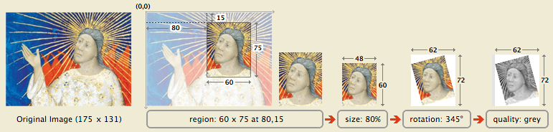
IIIF Image API
Two parts: Actual Pixels, Technical Metadata (JSON-LD)
Base URL: {scheme} : // {host} {/prefix} / {identifier}
Image Resource: {base} / {region} / {size} / {rotation} / {quality} / . {format}

Slide 11
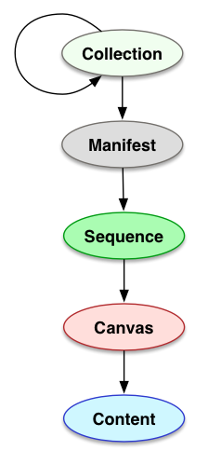
IIIF Presentation API
Collection is a list of objects or collections
Manifest describes an object
Sequences indicate page view order
Canvas describes a page or view
Images and annotations reference the canvas

Slide 12
IIIF Presentation API
Has just enough metadata to support a client presenting the digital cultural heritage object for the users to understand what they are interacting with
Shared Canvas data model (in JSON-LD)
Open Annotation data model
http://iiif.io/api/presentation/2.1/

Slide 13
IIIF Search API
provides a method for searching annotations that are associated with an object or image, such as machine-generated OCR of text or notes added by a scholar during their research.
http://iiif.io/api/search/1.0/

Slide 14
IIIF Authentication API
specifies how a data provider can serve access controlled IIIF content
specifies how to direct users to institutional login services

Slide 15
IIIF APIs
Taken together, these APIs provide a model for client-server interaction that can be used by image viewing and annotation tools such as Mirador and the Universal Viewer, as well as platforms such as ResearchSpace and ConservationSpace.

Slide 16
The IIIF community
Executive committee
11 core founding members and new founding members
editors committee
3 working groups: manuscripts, newspapers, museums, soon 3D

Slide 17
IIIF events & resources
Annual conference: http://iiif.io/event/2016/newyork/
Working groups: manuscripts, newspapers, museums (NEW! JOIN!)
Bi-weekly phone calls (details of which are posted in the iiif-discuss list. All community members are welcome and encouraged to participate in the calls. Notes from the calls are posted in this Google Drive folder.)
Discussion lists: https://groups/google.com/forum/#!forum/iiif-discuss & https://groups.google.com/forum/#!forum/iiif-announce
IIIF Community GitHub page: http://github.com/iiif

Slide 18
The IIIF members
11 → 35 core founding members
ARTstor
Bayerische Staatsbibliothek (Bavarian State Library)
La Bibliothèque nationale de France
British Library
Brown University
Cornell University
The J. Paul Getty Trust
Gottingen State and University Library
Harvard University
Indiana University
Johns Hopkins University
Leiden University
MIT Libraries
Nasjonalbiblioteket (National Library of Norway)
National Library of Israel
National Library of Poland
National Library of Scotland
New York University Libraries
Ohio State University
Oxford University (Bodleian Library)
Princeton University Library
Stanford University
University of Edinburgh
University of Hong Kong
University of Notre Dame
University of Pennsylvania
University of Toronto
Wellcome Trust
Yale University/Yale Center for British Art/Beinecke LIbrary

Slide 19
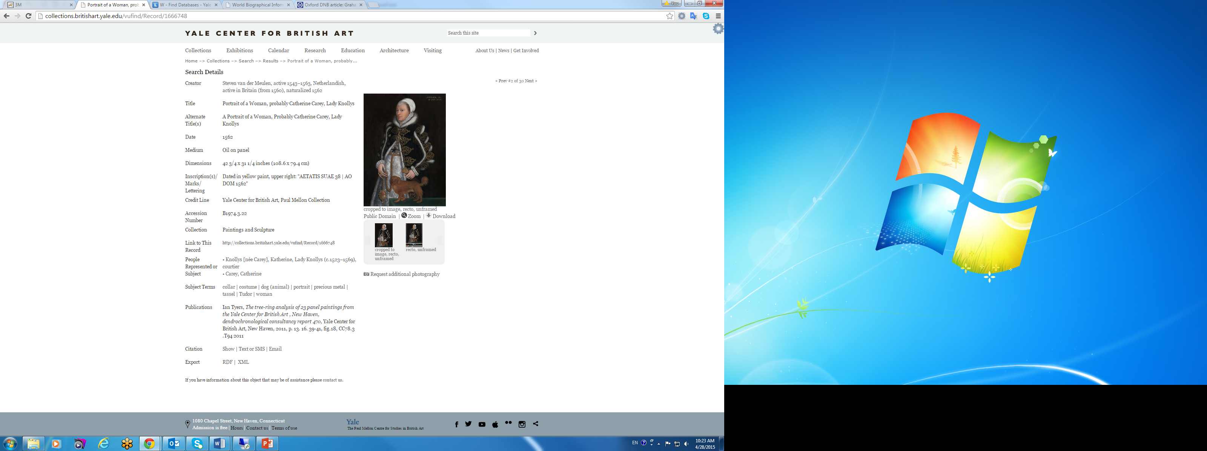
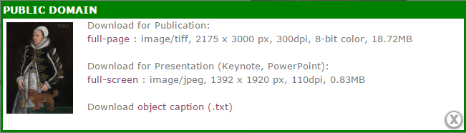
Dissemination of images
Notes:
Thousands of images of works in the Center’s collection believed to be in the public domain are available for free through the Center’s online collection catalogue, which will soon be BlackLight.
The green box shown here is where users choose the image sizes they can download free of charge.

Slide 20
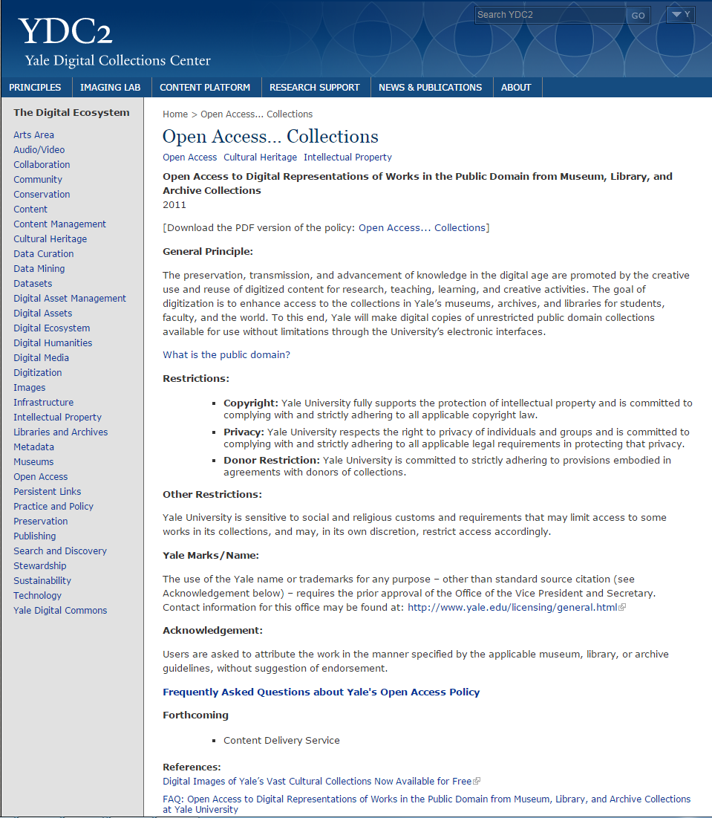
YCBA’s Implementation
of the
Yale Open Access Policy
for works in the
public domain
No authorization required
No fees due to the YCBA/Yale
Commercial purposes allowed
(http://ydc2.yale.edu/open-access-collections)
Notes:
Indeed, since 2011, under Yale University’s Open Access Policy, anyone may use the Center’s open access material without further application, authorization, or fees due to the Center or to Yale, that includes commercial purposes and high resolution images. (The Yale policy specifically addresses works in the public domain, and doesn’t address works under copyright.)
The YCBA implemented this policy with a great degree of openness, which was quite groundbreaking in 2011.
“I think we were one of, if not the first, to offer a completely straightforward, no strings attached hi-res download and to have a policy that placed no commercial or credit restrictions on usage whatsoever.” – Melissa Fournier, YCBA

Slide 21
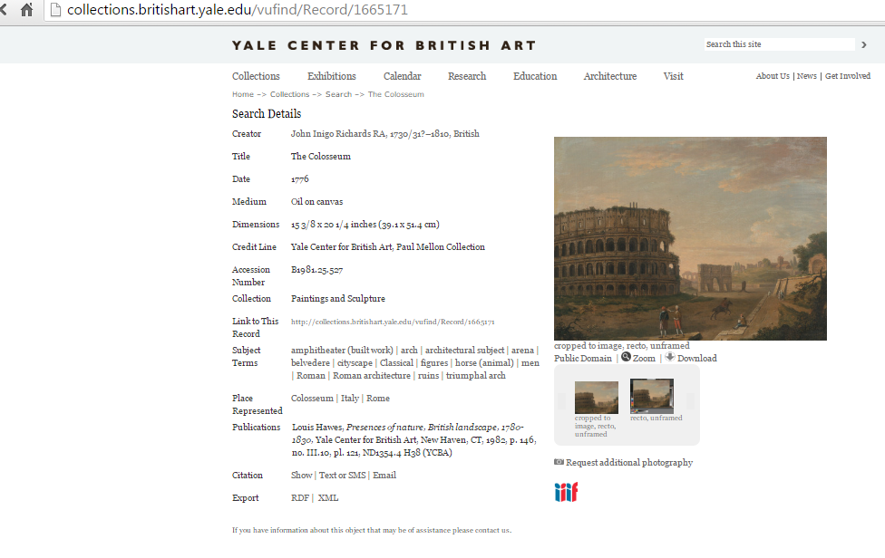
Mirador Viewer http://projectmirador.org/

Slide 22
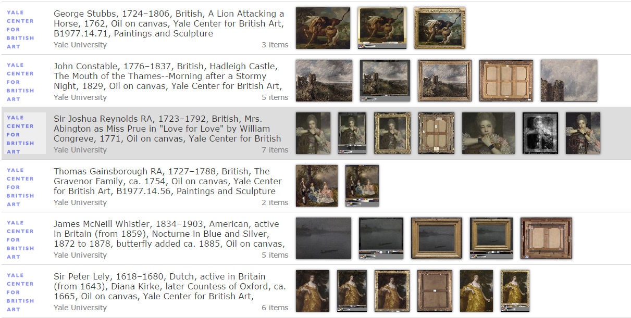
Mirador Viewer http://projectmirador.org/

Slide 23
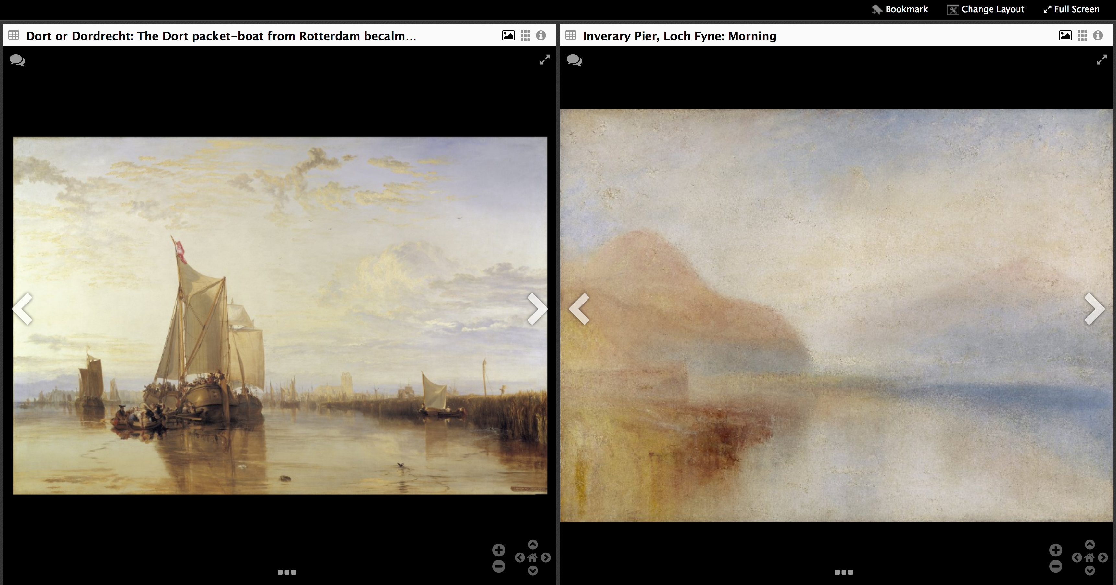
Mirador Viewer http://projectmirador.org/

Slide 24
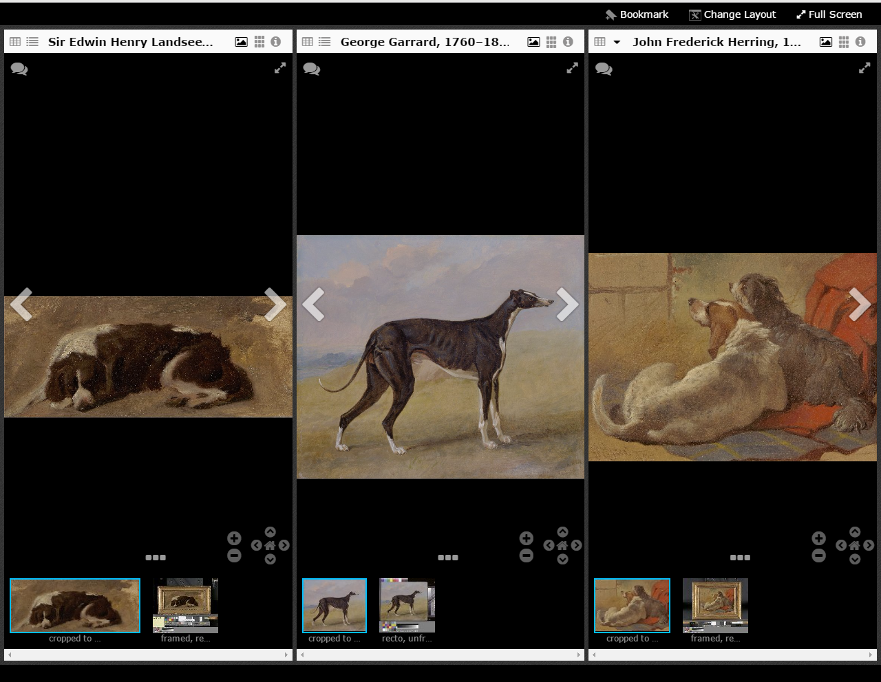

Slide 25
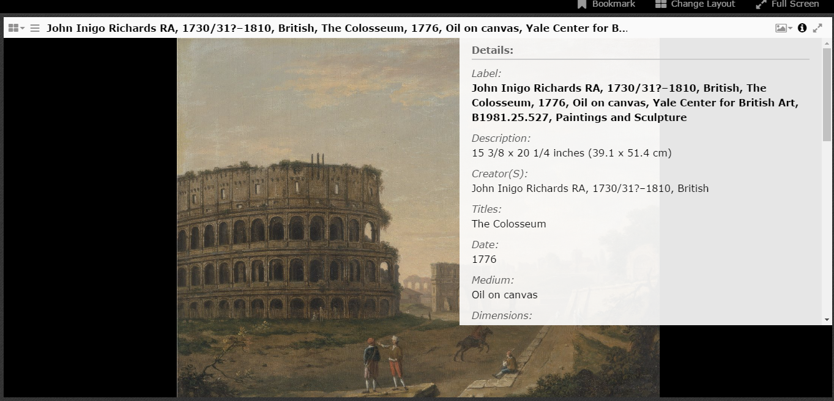

Slide 26
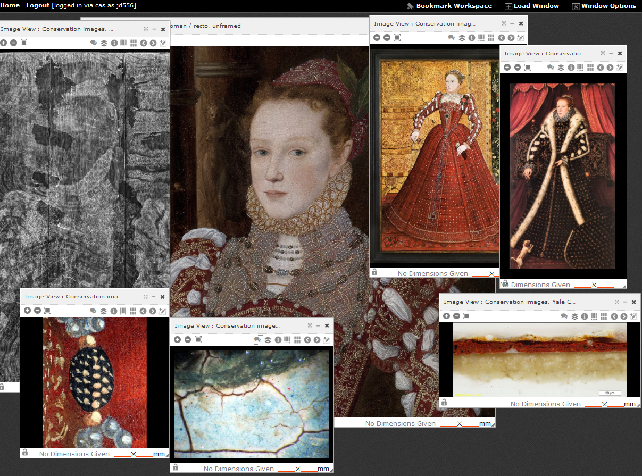
Emmanuelle Delmas-Glass @YaleBritishArt @edgartdata #CIDOC2016 #ICOMilano2016

Slide 27
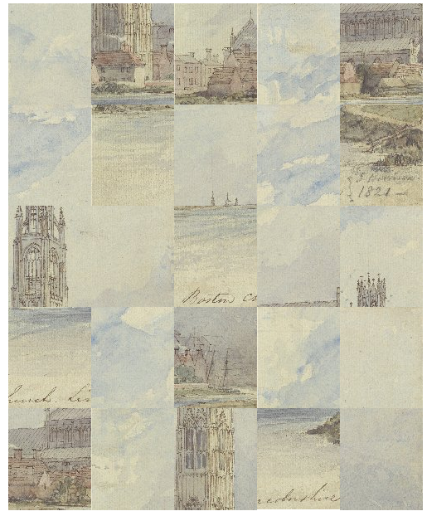
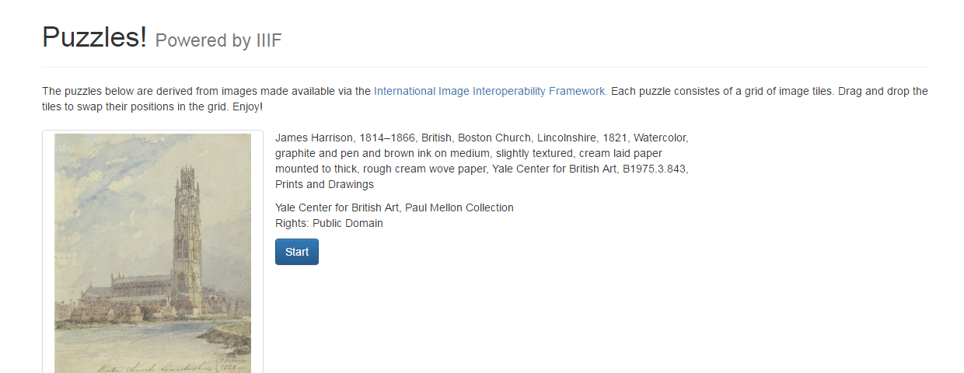
IIIF fun
http://puzzle.mikeapps.me/
Michael Appleby, IT Head, YCBA

Slide 28
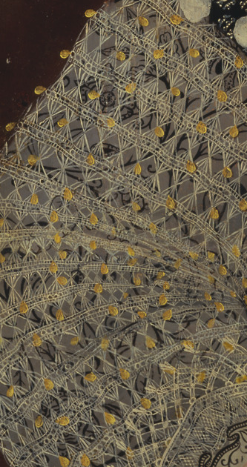
Benefits of IIIF
  Supports interoperability between image repositories
  Leverages YCBA’s open access resources
  Mirador: open source image viewer
  Originally conceived by Stanford University & now actively developed by an international community
  Yale (YCBA/Beinecke/ITS) Core Founding Member since May 2015
  Adopts the principles of Linked Data and the architecture of the Web in order to provide a distributed and interoperable system
Notes:
I am glad to report that IIIF and the Mirador image viewer measure up to our high standards and tick all the boxes of our digital strategy:
In terms of open access policy, IIIF not only supports interoperability between image repositories and breaks down the barriers between image databases/silos but it also leverages our open access resources. A note here to thank Melissa Fournier, YCBA’s Manager Imaging Services and Intellectual Property, whose forward thinking management of our digital assets was the crucial foundation for the Center’s adoption of IIIF, especially where Jpeg2000 are concerned.
It is an international standard actively developed by an active community
It works with a variety of image viewers, Mirador being an open source one.
And finally it outputs Linked Open Data, which, as you now know, has become a cornerstone of our digital strategy to correctly represent our scholarly content for the semantic web environment. The principles of Linked Data and the architecture of the Web are adopted in order to provide a distributed and interoperable system. (The Shared Canvas data model is leveraged in a specific, JSON based format that is easy to implement without understanding RDF, but is still compatible with it. As such it can be seen as a recommended serialization profile for Shared Canvas.)

Slide 29
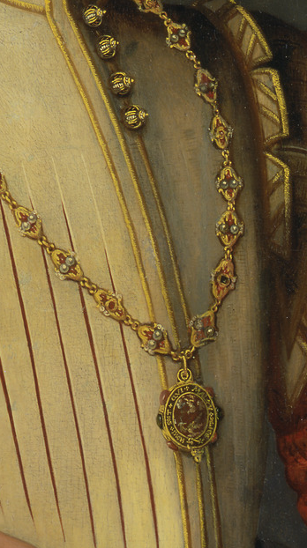
Conclusion
  The methodology that museums use for sharing their digital resources (data and images) with the network is critical
  Share our digital resources beyond our website in formats that allow for easy creative and scholarly reuse
    Interoperability of data and images through open source / shared development of tools and community developed standards
    Shared content
    Develop policies and technical implementations to free open content
Notes:
Our goal is to share our digital resources in formats that allow for easy creative and scholarly reuse so that we can contribute to the study of British Art worldwide. In addition to our semantic endpoint we plan on contributing our RDF dataset to the Mellon funded ResearchSpace.

Slide 30
  Thank you
  http://iiif.io/
  http://projectmirador.org/
  www.cidoc-crm.org/docs/CRMPrimer_v1.1.pdf
  CRM Mapping Memory Manager: 139.91.183.3/3M/
  http://britishart.yale.edu/collections/using-collections/technology
Michael Appleby, Head of IT, YCBA
Melissa Fournier, Manager Imaging Services and Intellectual Property, YCBA
Jessica David, Associate Conservator of Paintings, YCBA
Edward Town, Postdoctoral Research Associate, YCBA
Emmanuelle Delmas-Glass
Collections Data Manager
emmanuelle.delmas-glass@yale.edu
britishart.yale.edu

